Slide 1
Scratch (for Kids)
Presented by Tech Dawgs

Slide 2
What is Scratch?
Scratch is a programming language for kids. While it can’t create super advanced programs, it can create some basic games. Scratch is useful for learning basic programming concepts. If you like using Scratch, then you might like being a programmer.

Slide 3
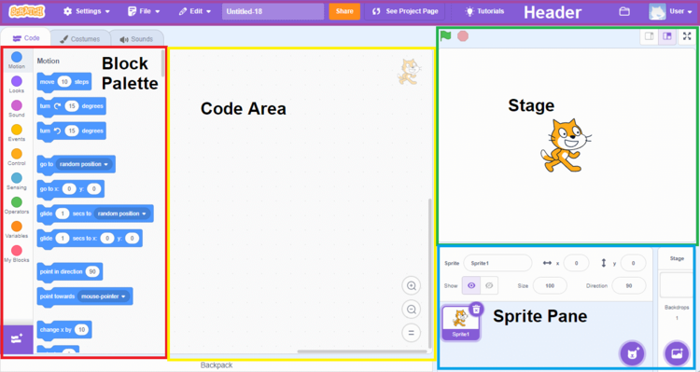
This is the basic layout of Scratch.
To use Scratch, you grab a block from the Block Palette on the left side of the screen and place it into the Code Area in the middle. These Blocks control the Sprite you have selected. You can see your Sprites in the Sprite Pane. The Stage is what your game currently looks like.

Slide 4
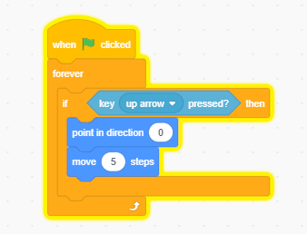
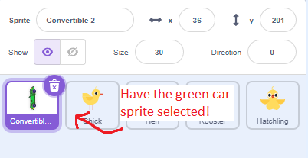
Look at the code example below. The game starts when the green flag is clicked. We want our code to start as soon as the game is started, our first block makes that happen. We then use an “if” block, which does an action if something is true. In this example, if the player presses the “up arrow” key, then it will move the Sprite forward by 5 steps.
We use the “forever” block to make sure it does this code forever, otherwise it would have only moved forward one time.
Let’s try adding some code! Make sure you have the green car sprite selected in the Sprite Pane. Then go ahead and drag the blocks into the code area. Try your best to make it look like the code pictured below.

Slide 5
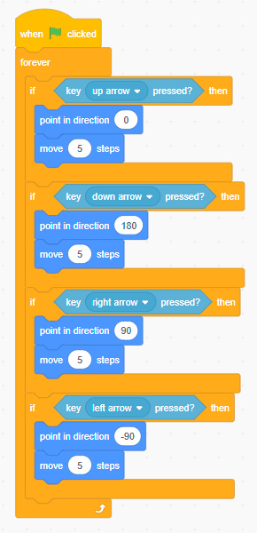
Now let’s add the same movement for the other 3 directions: left, right, and down. Try your best to make the code look like it does below.
After your done, try pressing the green flag to start, and practice moving your car around. Press the red button to stop.

Slide 6
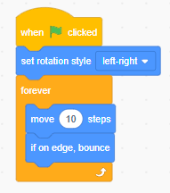
Now let’s add movement for the chickens! Select one of the chickens in the Sprites Pane and add the code below. This code makes the chickens walk left and right forever.
After your finished with one chicken, we will want to make all the other chickens have the same code. click on your blocks to highlight them (it will have a yellow border line) then simply drag it to another chicken sprite. It will copy and paste the blocks to the other chicken, which should save you time.
Try starting the game again to see your chickens moving.

Slide 7
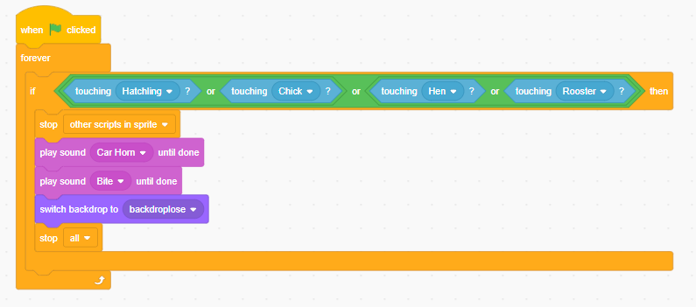
Let’s go back to the green car sprite. It’s time to add some more advanced code, we will make it so that the player loses the game if they hit a chicken with their car. We want it to play a sound if they lose, and we also want it to show a Game Over screen. We will add “stop” blocks to stop all other code once the game is over. This will give the chickens a break from having to run all the time.

Slide 8
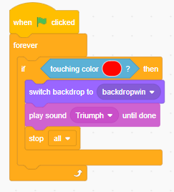
Now that we have added a way to lose, let’s add a way to win. If the player makes it across the road without hitting a chicken with their car, they win the game!
We will know they have won if their car has touched a red color. The finish line is the only red color in the game, so if they are touching red then it must be the finish line.

Slide 9
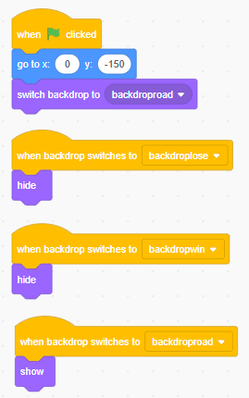
We are nearly done! But you may have noticed two issues if you tried to play the game.
1: the car does not go back to the starting place when you restart the game.
2: the car and chicken sprites are still visible on the game over screens.
These are easy fixes, just use the code below. We will make it so that the car goes back to its starting place whenever the game is started, and we will hide/show the car based on what backdrop is on the screen.

Slide 10
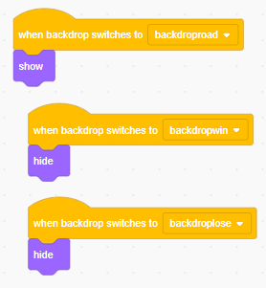
Final step! We have to make it so that the chickens also show/hide based on the current backdrop. We can use the code below on each chicken sprite.

Slide 11
Congratulations, you have made your first game in Scratch!
Go ahead and keep experimenting with Scratch. Listed below is some ideas that you can try, or you can do your own thing. Its entirely up to you, the possibilities are endless.
You can try these ideas if you don’t know what to do:
See if you can move the sprites around on the Stage, you can click on the chickens to move them somewhere else.
Make the chickens or the car go faster by changing how many steps they take!
You can make the car/chickens as large or as small as you want, look for the Size option somewhere in the Sprite Pane.
If your really confident in your skills, try adding and changing code to create a second level to the game.

